Slide 1
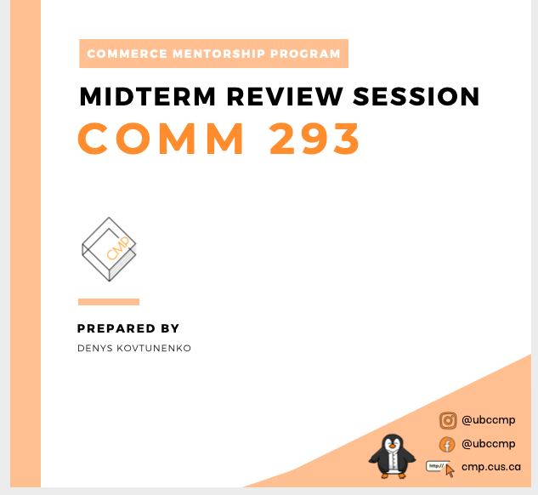

Slide 2
Table of Contents
Chapter 1: Accounting in Action
Chapter 2: The Recording Process
Chapter 3: Adjusting the Accounts
Chapter 4: Completing the Accounting Cycle
Chapter 5: Accounting for Merchandising Operations
Chapter 6: Inventories
Chapter 8: Recognition of Accounts Receivable

Slide 3
Chapter 1: Accounting in Action

Slide 4
What is Accounting? (boring version)
Recognizing, recording, communicating economic activities
Interested users:
Internal (management)
External (shareholders)
Different types:
Cost accounting
Audit
Tax
Deliver financial info to concerned users

Slide 5
What is Accounting? (better version)
Language of financial information
Words in a sentences = numbers in financials
Wealth lies in financial literacy
Reading numbers to get ahead
Don’t believe me… Warren Buffet

Slide 6
Warran Buffet on Accounting
https://www.youtube.com/watch?v=rV3Etfww7EQ&ab_channel=InvestmentKnowledge

Slide 7
Financial vs Managerial Accounting
Financial Accounting
Collecting data for financial statements
Emphasis on past
External users
Follow GAAP/IFRS
Managerial Accounting
Collecting data for business decision-making
Emphasis on future
Internal users
Follow logic

Slide 8
Assets
Economic resources controlled by the company
Result from past business events
Expected future economic benefits
Recorded at historical cost
The cost of acquisition
Examples:
Accounts receivable
Inventory
PPE
Cash

Slide 9
Liabilities
Debts/firm obligations
Result from past business events
Expected future outflow of economic resources
Examples
Accounts payable
Unearned revenue
Notes payable
Principal & interest payments

Slide 10
Shareholders’ Equity
Contributed capital
Permanent Investments for equity
Common stock
# & total value of shares issued
Retained Earnings
Consists of revenues, less expenses and dividends
Other
Changes in values of assets/liabilities

Slide 11
The Accounting Equation
Assets = Liabilities + Shareholders’ Equity
Must always remain balanced
Only 2 ways to acquire assets
Ex. 1) If Amazon has $700K in assets and $200K in liabilities, what is the balance in SE?

Slide 12
Generally Accepted Accounting Principles (GAAP)
Universal set of accounting regulations
In Canada:
Public companies follow International Financial Reporting Standards (IFRS)
Private companies can follow IFRS or ASPE
In USA:
Comply with US GAAP
Regulated by the SEC

Slide 13
Chapter 2: The Recording Process

Slide 14
Accounting Equation – Expanded
Assets = liabilities + SE
SE = common stock + retained earnings (RE)
RE = net income – dividends
RE = revenues – expenses – dividends
Assets = liabilities + common stock + revenues – expenses - dividends

Slide 15
Transaction Analysis
1) Identify accounts involved
2) Determine direction of effect
3) Check that A = L + SE remains balanced
Duality of effects
Every transaction affects min. 2 accounts

Slide 16
Transaction Analysis – Examples
2) Amazon issues $8,000 of common shares to investors for cash.
3) Amazon borrows $19,000 from the bank with a 5-year note.
4) Amazon buys $3,000 in new equipment for deliveries. They pay $2,000 in cash, and agree to a 3-year note for the remainder balance.

Slide 17
Journal Entries
Method for analyzing transactions
Recording as either “Debit” or ”Credit”
ONLY signal left and right
Summarize results of economic transactions

Slide 18
Journal Entries – Examples
5) Amazon issues $8,000 of common shares to investors for cash.
6) Amazon borrows $19,000 from the bank with a 5-year note.
7) Amazon buys $3,000 in new equipment for deliveries. They pay $2,000 in cash, and agree to a 3-year note for the balance.

Slide 19
General Ledger
Shows effects of multiple economic transactions
Isolates balances for each individual account

Slide 20
General Ledger – Examples
8) Amazon issues $8,000 of common shares to investors for cash.
Amazon borrows $19,000 from the bank with a 5-year note.
Amazon buys $3,000 in new equipment for deliveries. They pay $2,000 in cash, and agree to a 3-year note for the balance.

Slide 21
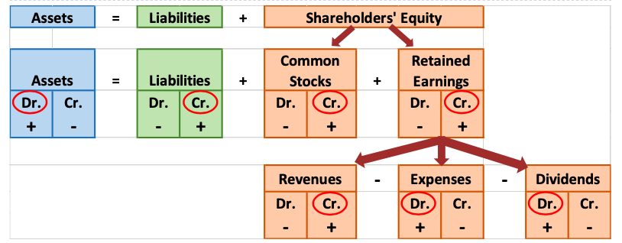
Debit and Credit Framework
Gain = economic benefit outside regular operations
Loss = economic loss outside regular operations

Slide 22
Debits and Credits for Journal Entries
D.E.A.D
Debit expenses, assets, dividend increases
Credit all other increases
Debits = Credits ALWAYS

Slide 23
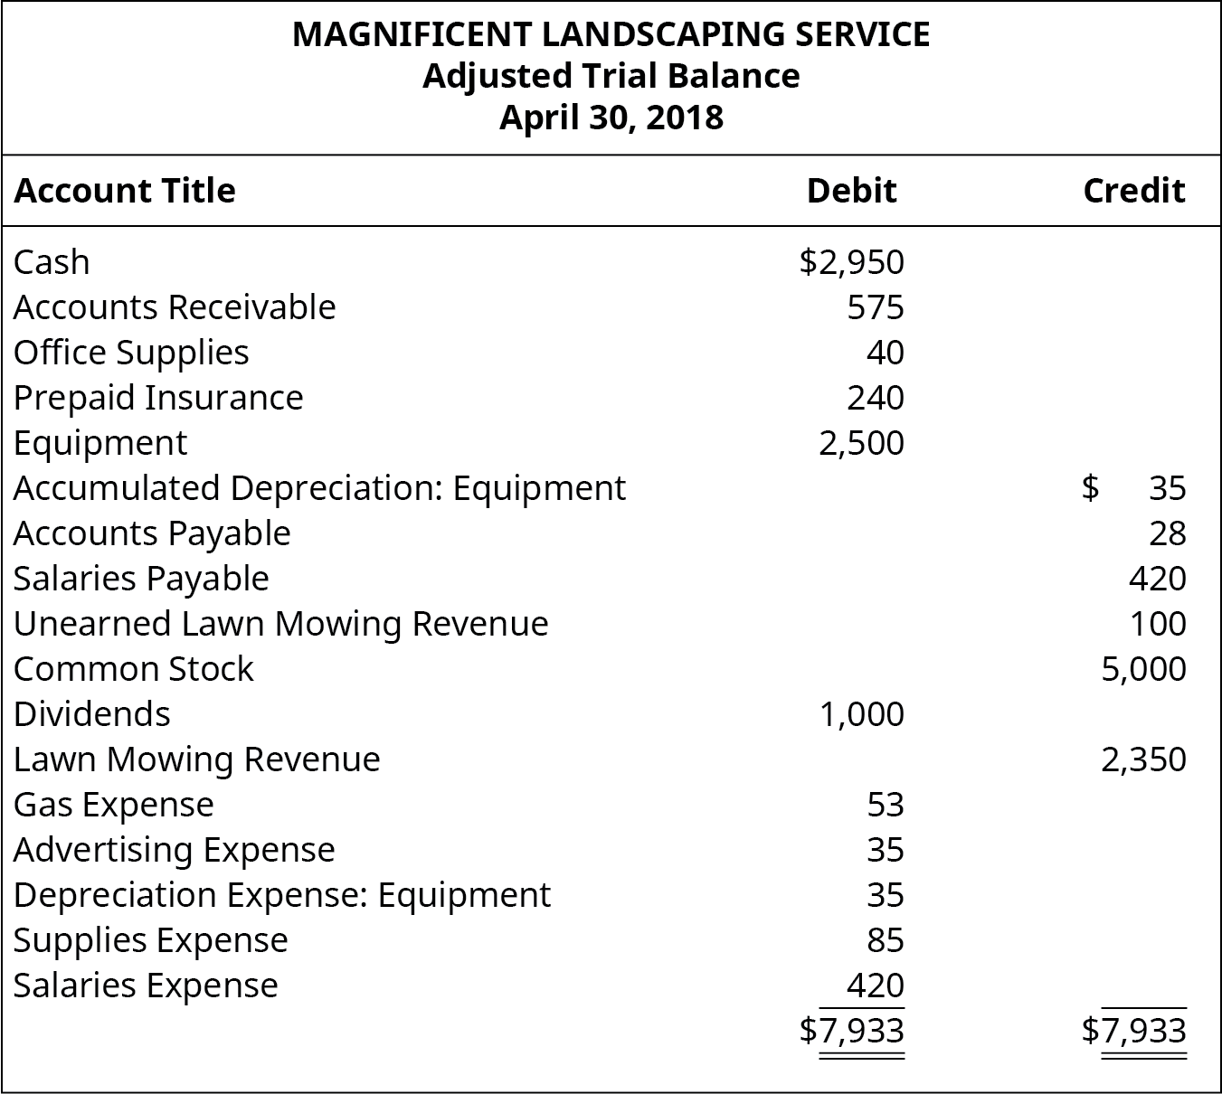
Trial Balance
Notes:
Trial balance is a list of accounts and their balances at a given time
􏰀 Companies usually prepare a trial balance at the end of an accounting period
􏰀 Debits = Credits

Slide 24
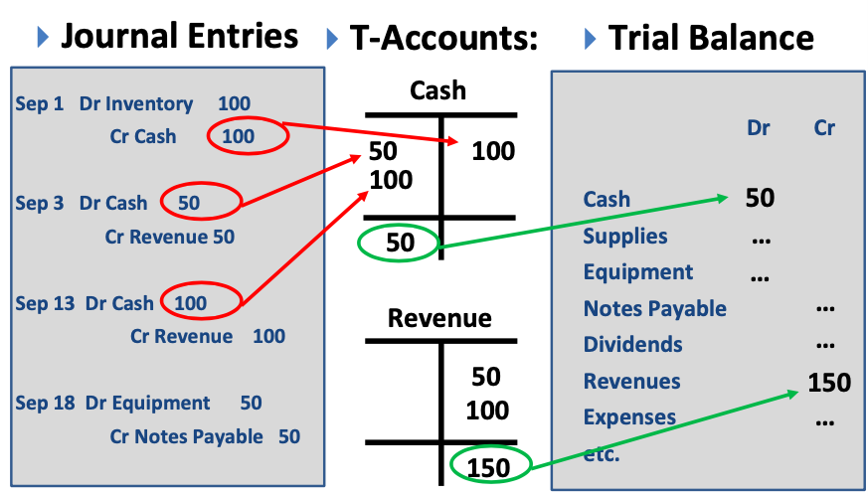
Chapter 2 Summary

Slide 25
Chapter 3: Adjusting the Accounts

Slide 26
Accounts Receivable vs Accounts Payable
AR
Records amounts for goods/services given on credit
Money owed TO company
Asset
AP
Records amounts for goods/services received on credit
Money owed BY company
Liability

Slide 27
Methods of Measuring Income
Cash Basis
Revenues/expenses recorded at transfer of cash
Not used often, not GAAP
Can be manipulated by management
Accrual Basis
Revenues/expenses recorded as incurred
Used most often, follows GAAP
Independent of cash receipts timing

Slide 28
Revenue Recognition Principle – Examples
1) Cash received BEFORE revenue is earned
Dr Cash
Cr Unearned revenue (liability)
2) Cash received WHEN revenue is earned
Dr Cash
Cr Sales revenue (retained earnings)
3) Cash received AFTER revenue is earned
Dr Accounts receivable
Cr Sales revenue
Notes:
Show what happens later

Slide 29
Revenue Recognition Principle
Revenues to be recorded when earned
Independent of when cash is received/paid
9) Ex: Amazon sold $5,000 worth of merchandise on Feb 8, but cash payment was collected on Feb 22. When is revenue recognized? Journal entries:

Slide 30
Expense Recognition Principle – Examples
1) Cash paid BEFORE expense is incurred
Dr Prepaid expense (asset)
Cr Cash
2) Cash paid WHEN expense is incurred
Dr Expense
Cr Cash
3) Cash paid AFTER expense is incurred
Dr Expense
Cr Expense payable
Notes:
Dr expense whatever it may be, rent etc….
Show what happens later

Slide 31
Expense Recognition Principle
Expenses to be recorded when earned
Independent of when cash is received/paid
10) Ex: Amazon’s employees earned a $1500 bonus for the sale of merchandise on Feb 8, but it was paid out on Feb 22. When is the expense recognized? Journal entries:

Slide 32
Two Kinds of Adjusting Entries
Deferrals
Receipt of assets/cash BEFORE incurring revenue/expense
Ex. prepaid expenses, unearned revenues
Accruals
Receipt of assets/cash AFTER incurring revenue/expense
Ex. accrued revenues/expenses

Slide 33
Deferrals Example
11) Sam spent $900 on Mar 1st to cover the month’s car insurance fee. What are the journal entries on Mar 1st and Mar 31st ?

Slide 34
Accruals Example
12) Sam decided to open a hair salon. On Mar 3, John came and received a $20 haircut on credit. Next week on Mar 7, John sent an e-transfer to cover the cost of the haircut. What are the Mar 3 and Mar 7 journal entries for Sam and John?

Slide 35
Depreciation
Method for allocating cost of tangible asset
Journal entry: Dr Depreciation Expense, Cr Accumulated Depreciation
Depreciation expense for current (single) period
Accumulated depreciation -> contra-asset account
Accounts for multiple periods of depreciation
Depreciation expense = depreciable amount / useful life
Depreciable amount = (cost of acquiring – residual value) / useful life

Slide 36
Accumulated Depreciation vs Depreciation Expense
Accumulated Depreciation
Credit balance
Contra-asset account, offsets assets on balance sheet
Permanent account
Depreciation Expense
Asset depreciation for 1 period
Appears on income statement
Temporary account

Slide 37
Adjusting Entries – Depreciation
13) Amazon bought a delivery truck for $100K on Mar 1, 2018. The truck has a useful life of 10 years and is expected to generate annual sales of $500K with no residual value. Mar 1, 2018 journal entries:
Adjusting entries on Dec 31, 2018 for depreciation:

Slide 38
Book Value
Book value = cost of depreciable asset – accumulated depreciation
14) Ex. Amazon bought a delivery truck for $100K on Jan 1, 2017. The truck has a useful life of 10 years and is expected to generate annual sales of $500K with no residual value. Book value at Dec 31, 2022?

Slide 39
Expenses Misstatement - Example
Payments cover beyond current period
15) Ex. A business paid $200,000 in commissions for 2 years at the start of their fiscal year. They recorded this journal entry:
Dr Commissions Expense $200,000
Cr Cash $200,000
Adjusting journal entry at year end:
Notes:
Overstated

Slide 40
Chapter 4: Completing the Accounting Cycle

Slide 41
Purpose of Closing Process
Balance sheet items roll-forward balances
I/S items don’t roll forward balances
Must create 0 balance in temporary accounts
Allocate net income/loss to retained earnings

Slide 42
Permanent vs Temporary Accounts
Permanent Accounts
Assets
Liabilities
Shareholders’ Equity
Temporary Accounts
Revenues
Expenses
Gains
Losses
Dividends declared

Slide 43
Step 1) Closing Revenues to Income Summary
16) Ex. Amazon has balances of $10,000 in sales revenue, $7,000 in service revenue and $100 gain from investments.
Notes:
Draw the t charts

Slide 44
Step 2) Closing Expenses to Income Summary
17) Ex. Amazon has balances of $5,000 in marketing, $4,000 in consulting, $2,000 in management fees, and $1000 in travel expenses

Slide 45
Step 3) Close Income Summary to Retained Earnings
18) Income Summary has a balance of $5,100

Slide 46
Step 4) Close Dividends to Retained Earnings
19) Ex. Amazon has a dividend balance of $600
Notes:
Dr RE, Cr Div

Slide 47
Skipping Income Summary
Closing revenues:
Dr Revenues/Gains
Cr Retained Earnings
Closing expenses:
Dr Retained Earnings
Cr Expenses/Losses
Closing dividends:
Dr Retained Earnings
Cr Dividends

Slide 48
Balance Sheet Classifications
Current assets
Expected usage within 1 year
Long-term investments
PPE
Intangible assets
Current liabilities
Obligations due within 1 year
Obligations paid after 1 year
Accounts ordered by liquidity
Notes:
AR, cash, supplies,
Investments in stocks/bonds, land, buildings, long term notes receivable
Don’t have physical substance, like patents, copyrights, goodwill
AP, salaries payable, interest payable

Slide 49
Operating Cycle
Time period for inventory to turn to cash
1) Purchase inventory
2) Sell it on account
3) Collect payment from customers
Approximately 1 year

Slide 50
Chapter 5: Accounting for Merchandising Operations

Slide 51
Merchandising Companies
Product/goods oriented rather than services
Retailers (sales direct to end-users)
Ex. Walmart, Superstore
Wholesalers (sales to retailers)
Ex. Proctor & Gamble, General Mills
Hold inventory as current asset
COGS is total cost of goods (inventory) sold

Slide 52
Perpetual vs Periodic Inventory Systems
Perpetual
Constant tracking of inventory changes
Better control over inventory
Real time reporting of profits
Expensive to maintain
Common for high-value goods
Periodic
Does not keep constant track of inventory changes
COGS calculated only at the end
Not always up to date
Inventory adjusted end of period

Slide 53
Cost of Goods Sold (COGS)
Direct cost of goods acquired that were sold
Cost incurred only if inventory is sold
Essential in matching principle

Slide 54
Perpetual Inventory – Delivery Costs
If seller pays for delivery of inventory:
Dr Delivery Expense
Cr Cash/AP
No journal entries for buyer
If buyer pays for delivery of inventory:
Dr Inventory
Cr Cash/AP
Included in overall cost of inventory

Slide 55
Perpetual Inventory – Delivery Costs Example
20) Amazon buys $8,000 worth of product from Apple on Mar 3 and pays $200 delivery costs on credit. The journal entries for Amazon:
21) If Apple (the seller) takes care of the delivery costs, the journal entries for the shipment for Amazon and for Apple are:

Slide 56
Perpetual Inventory – Purchase Discounts
Discount granted on sale of inventory
Journal entries
Dr AP
Cr Inventory
Cr Cash

Slide 57
Perpetual Inventory – Purchase Allowance
Reduction in price due to item defect/wrong order
Journal entries
Dr AP
Cr Inventory

Slide 58
Perpetual Inventory – Purchase Return
Customer returns item to merchandiser
Journal entries
Dr AP
Cr Inventory

Slide 59
Credit Terms
Ex. Nike bought $10,000 worth of clothes from XYZ on account with credit term 3/12, n/30
Three-twelve, net thirty
3 % discount if paid within 12 days, else full balance in 30 days

Slide 60
Credit Terms – Example
22) Ex. Amazon bought $60K worth of tech on account from Apple on Mar 2 with credit terms 4/10 , n/30.
Mar 2 journal entries for Amazon:
Assuming Amazon pays on Mar 11, journal entries:
Assuming Amazon pays on Apr 1, journal entries:

Slide 61
Perpetual Inventory – COGS Example
23) Amazon sold $10,000 of tech on credit to customers on Mar 14. The tech cost Amazon $1,500 at the time of the transaction. Journaling the credit sale for Amazon:
Journaling the COGS for Amazon:

Slide 62
Perpetual Inventory – Purchase Returns Ex.
24) Amazon bought too much tech from Apple and opted to return $5,000 of tech to Apple on Mar 5. The tech cost Apple $2,000 to make. The journal entries for Amazon:
The journal entries for Apple:
Sales returns and allowances -> contra-revenue account for the seller

Slide 63
Sales Returns & Allowances – for Seller
Sales return (customer returns product for refund)
Dr Sales returns and allowances*
Cr Accounts receivable
Sales allowance (customer granted price reduction as compromise for incorrect order/broken product)
Dr Sales returns and allowances*
Cr Accounts receivable
*Contra-revenue accounts
Deducted from gross sales revenue to determine net sales
Debit balance, increases lower revenues

Slide 64
Net sales reporting
Sales revenue
Less: Sales Discounts
Sales returns & allowances
Net Sales
Less: COGS
=Gross profit (gross margin)

Slide 65
Net income reporting
Multi-step income statement
= Gross profit
Less: Operating expenses
= Operating income before taxes
Less: Taxes
= Net Income
Operating expenses are rent, supplies, salaries, advertising

Slide 66
Income Statement Equations
Gross profit = Net sales – COGS
Gross profit rate = Gross profit / Net sales
Single-step I/S:
Net income = Revenues – Expenses
Multi-step I/S:
Net income = Gross profit – Operating expenses
Net income = Net sales – COGS – Operating expenses

Slide 67
Gross Profit Rate vs Markup
Gross profit rate
Based on net sales
(Net sales – COGS) / Net sales
Markup
Based on price
(Sales price – cost) / cost * 100
25) Ex. Amazon marks up phone to sell for retail at $800 that cost $200 to make. Determine the markup and gross profit rate.

Slide 68
Chapter 6: Inventories

Slide 69
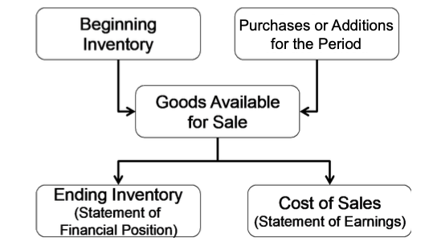
Cost of Sales

Slide 70
Determining Ownership of Goods
FOB shipping point
Possession passes to buyer when goods are shipped
Buyer pays transport costs
FOB destination
Possession passes to buyer when goods are delivered
Seller pays transport costs
Consigned goods
Inventory given to a 3rd party (consignor) to sell
Still belongs to manufacturer/merchandiser
Possession not transferred, no revenue recognition

Slide 71
Inventory Cost Flow Methods: First-In, First-Out (FIFO) Assumptions
Earliest goods bought are 1st to be sold
1st (oldest) goods are first to be recognized as COGS
Oldest units not actually sold first (but their costs are recognized first)
Oldest costs -> COGS
Newest costs -> Ending inventory
Used in periodic inventory (not in perpetual)

Slide 72
FIFO Example
26) Superstore bought 500 chocolate boxes at $0.9 each on Mar 2. Then, they bought 200 chocolate boxes at $0.7 each on Mar 5. Finally, they bought 300 chocolate boxes at $0.5 on Mar 10. All chocolate boxes are identical. On Mar 12, Superstore sold 400 chocolate boxes at $3 each. Determine COGS and ending inventory on Mar 12.

Slide 73
Inventory Cost Flow Methods: Last-In, First-Out (LIFO) Assumptions
Latest goods bought are 1st to be sold
Latest (newest) goods are first to be recognized as COGS
Newest units not actually sold first (but their costs are recognized first)
Newest costs -> COGS
Oldest costs -> Ending inventory
Used in periodic inventory (not in perpetual)

Slide 74
LIFO Example
27) Superstore bought 500 chocolate boxes at $0.9 each on Mar 2. Then, they bought 200 chocolate boxes at $0.7 each on Mar 5. Finally, they bought 300 chocolate boxes at $0.5 on Mar 10. All chocolate boxes are identical. On Mar 12, Superstore sold 400 chocolate boxes at $3 each. Determine COGS and ending inventory on Mar 12.

Slide 75
Inventory Cost Flow Methods: Average Cost
Average cost = COGAS / # units available for sale
Average cost assigned to COGS and ending inventory
COGS = (avg. cost per unit) x (# units sold)
Ending inventory = (avg. cost per unit) x (# units in ending inv.)

Slide 76
Average Cost Example
28) Superstore bought 500 chocolate boxes at $0.9 each on Mar 2. Then, they bought 200 chocolate boxes at $0.7 each on Mar 5. Finally, they bought 300 chocolate boxes at $0.5 on Mar 10. All chocolate boxes are identical. On Mar 12, Superstore sold 400 chocolate boxes at $3 each. Determine COGS and ending inventory on Mar 12.

Slide 77
Inventory Cost Flow Methods: Other Notes
During rising prices/inflation
FIFO -> lowest COGS, highest ending inventory
LIFO -> highest COGS, lowest ending inventory
Above reversed if falling prices
Avg. cost yields net income between FIFO, LIFO (regardless of rising/falling prices)
Managers are motivated to choose certain methods
IFRS prohibits LIFO
U.S. GAAP allows FIFO, LIFO, and weighted avg. cost methods

Slide 78
Financial Statement Ratios: Inventory Turnover
Inventory turnover = cost of sales / avg. inventory
Avg. inventory = (beginning inventory + ending inventory) / 2
How many times avg. inventory was produced and sold
High ratio -> fast moving inventory

Slide 79
Financial Statement Ratios: Average Days in Inventory
Avg. days in inventory = 365 / inventory turnover ratio
How long inventory is expected to be held
Higher numbers -> concern for product obsolescence

Slide 80
Chapter 8: Recognition of Accounts Receivable

Slide 81
Types of Receivables
Accounts receivable (trade receivables)
Credit sales
Current asset (collectible within <1 year)
Notes receivable
Written promises from parties with specific terms on payment
Other receivables
Owed to company for reasons other than regular operating transactions
Ex. loans to employees

Slide 82
Recording Receivables
Increased when revenue is recognized
Dr Accounts receivable
Cr Sales revenue
Reduced on collection of payments
Dr Cash
Cr Accounts receivable
Reduced on returns/allowances
Dr Sales returns/allowances
Cr Accounts receivable

Slide 83
Receivables review from Chapter 5
29) Amazon bought $16,000 of tech from Apple on account. Apple granted Amazon 3% discount. What are the journal entries for Apple?
Amazon returns $4,000 of tech to Apple that was bought on account. What are the journal entries for Apple?

Slide 84
Merchandise Cards
Preferred by management, lower transaction costs
Visa, MasterCard take commissions
Increases sales revenue, if receivables collected
30) Ex. A shopper bought $500 of food at Superstore using a Superstore credit card on Mar 1. They didn’t pay the $500 balance at the end of the month, and Superstore charges 4% per month on the balance. Journal entries for Superstore:

Slide 85
Third-Party Credit Cards
Non-merchandise cards
Visa, Mastercard, American Express
Retailers record a service charge expense
31) Ex. A shopper bought a $300 coat from Zara and paid for it with Mastercard. Mastercard charges a 2% service fee. Journal entries for Zara:

Slide 86
Uncollectible Accounts Receivable
Uncollectible balances in AR -> Bad debt expense
Direct method
Write-off when the actual uncollectible results in a loss
Dr Bad debt expense
Cr Accounts receivable
Direct method issues
Not following matching principle (write-off may happen in subsequent period to earned revenue)
Depends on knowing when AR is uncollectible
Generally not allowed in financial reporting

Slide 87
Allowance Method for Bad Debts
An estimate is made for the expected amount of bad debt for the period
Dr Bad debt expense
Cr Allowance for doubtful accounts (contra-asset account)
If account is confirmed to be uncollectible:
Dr Allowance for doubtful accounts
Cr Accounts receivable
If previously written-off account becomes collectible:
Dr Accounts receivable
Cr Allowance for doubtful accounts

Slide 88
Bad Debt Expense vs Allowance for Doubtful Accounts
Bad Debt Expense
Temporary account
Expense on I/S
Estimated uncollectible AR amount for current period
Allowance for Doubtful Accounts
Permanent account
Contra-asset, balance sheet
Accumulates over time, reduces total value of AR

Slide 89
Estimating Bad Debt Expense
% of credit sales method
(Credit sales) x (% estimated to be uncollectible)
% usually based on prior credit history
Aging of accounts receivables method
Estimate % of bad debt within different age groups of receivables
Computes estimate for total outstanding bad debt -> ending ADA balance
Record bad debt expense to adjust to the ADA balance

Slide 90
Estimated Bad Debt Expense – Example
32) Amazon uses the % of sales method. They estimate that 5% of net credit sales for 2021 will be uncollectible. If net credit sales are expected to be $15,000 for 2021, journalize the expected bad debt.
Amazon determined that $3,000 was uncollectible after some customers went bankrupt, so they wrote it off from AR. Journalize:

Slide 91
Estimated Bad Debt Expense – Example
32) Later, Amazon collected $7,000 of AR that was previously written-off. Journalize:

Slide 92
Estimated Bad Debt Expense – Example
Amazon’s total AR for year ended 2020
Not yet due = $400K (1% estimated uncollectible)
1-30 days overdue = $500K (3% estimated uncollectible)
31-60 days overdue = $150K (5% estimated uncollectible)
61-90 days overdue = $100K (12% estimated uncollectible)
Over 90 days overdue = $50K (20% estimated uncollectible)
33) Estimated bad debt expense if balance in ADA is $30K?
Notes:
59.5K

Slide 93
Selling Accounts Receivable
Collecting payments from clients too costly
Generate liquidity
Cost to sell is lower than not collecting at all
34) Ex. If Amazon decides to sell $140,000K worth of receivables at a 6% service charge, the journal entries are:

Slide 94
Financial Statement Ratios: Receivables Turnover
Receivables turnover = Net credit sales / avg. net AR
Tells # of times avg. receivables are recorded & collected during the year
Higher ratio -> faster collection of receivables
35) Ex. Amazon had net sales of $30M in 2021, 75% of which were on credit. Receivables at Dec 31, 2021 were $300K and at Dec 31, 2021 were $250K. Receivables turnover =

Slide 95
Financial Statement Ratios: Average Collection Period
Avg. collection period = 365 / receivables turnover
Tells on avg. how long it takes customers to pay
Lower numbers -> usually better
36) Ex. Following last Amazon example, avg. collection period is:

Slide 96
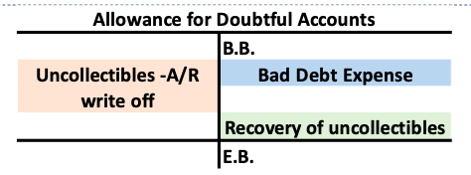
Allowance for Doubtful Accounts Summary

Slide 97
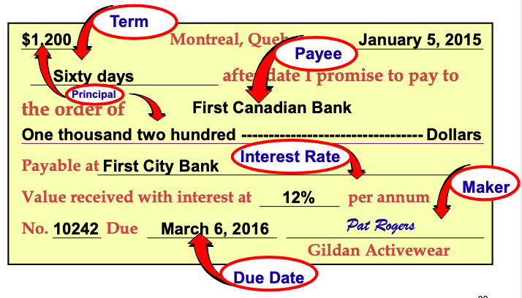
Notes Receivable
Contractual right to receive cash
Written promise
Principal + interest

Slide 98
Notes Receivable – Calculating Interest
Formula = (face value of note) X (annual interest rate) X (time in terms of 1 year)
37) Ex. Amazon issued a promissory note for $700,000 with 11% annual interest on July 1rd 2021. Calculate the interest income in Nike’s books on Aug 31th 2021 and journal the entries:

